Slide 1
Faster RCNN
PIRL, POSTECH

Slide 2
Dataset
Model
Test

Slide 3

Pascal VOC 2012
http://host.robots.ox.ac.uk/pascal/VOC/voc2012/

Slide 4
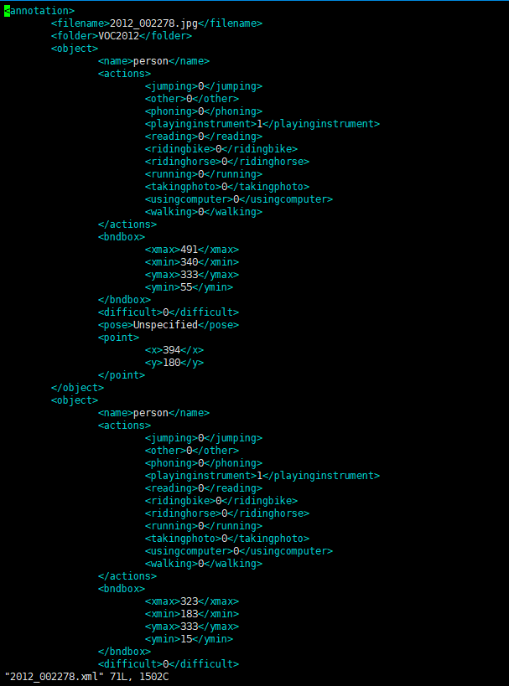

Pascal VOC 2012
./dataset/VOCdevkit/VOC2012/JPEGImages/2012_002278.jpg
./dataset/VOCdevkit/VOC2012/Annotations/2012_00278.xml

Slide 5
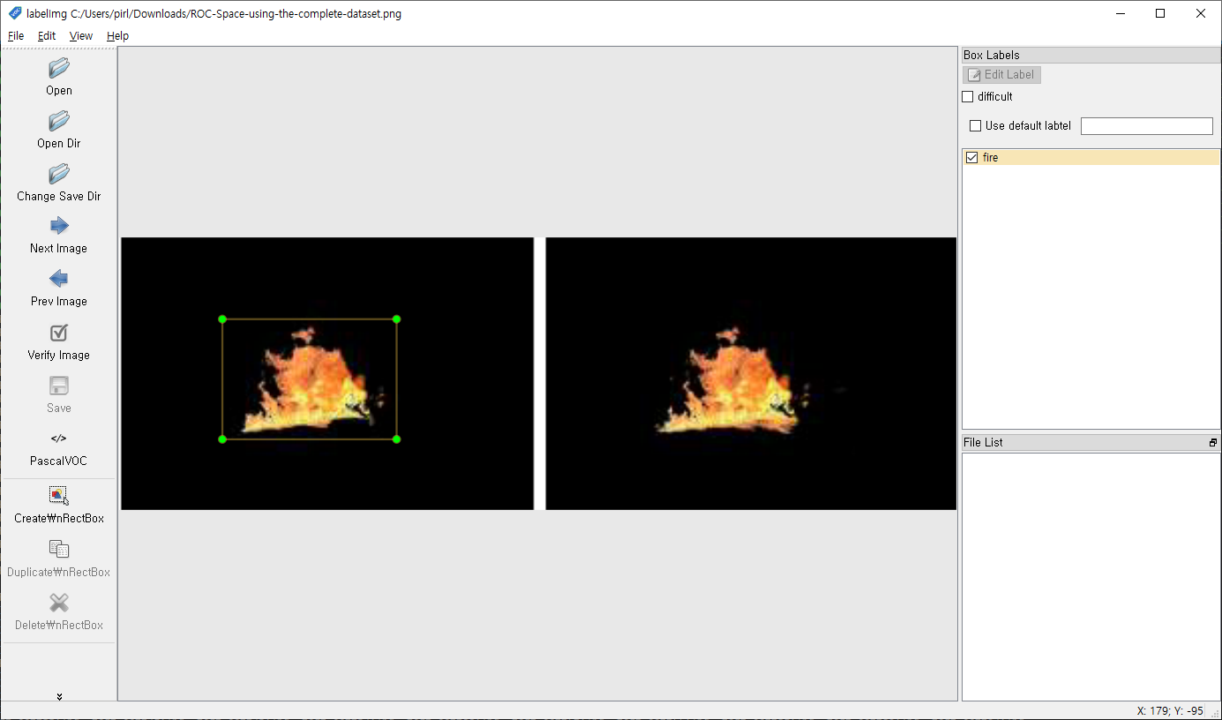
Annotaion tool
https://github.com/tzutalin/labelImg
https://www.youtube.com/watch?v=p0nR2YsCY_U&feature=youtu.be

Slide 6
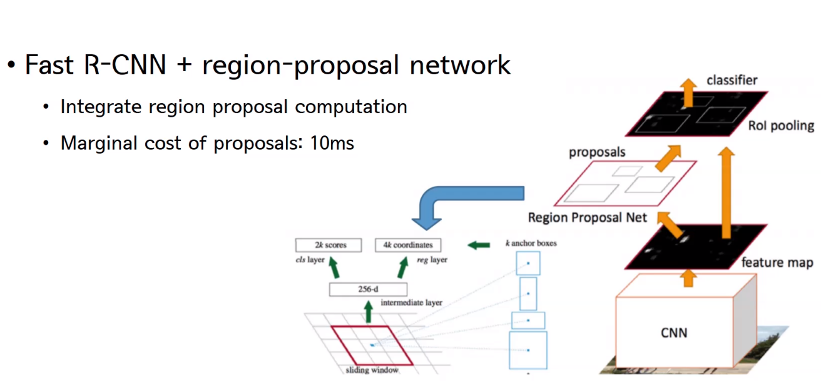
Faster RCNN
https://github.com/tzutalin/labelImg
https://www.youtube.com/watch?v=p0nR2YsCY_U&feature=youtu.be

Slide 7
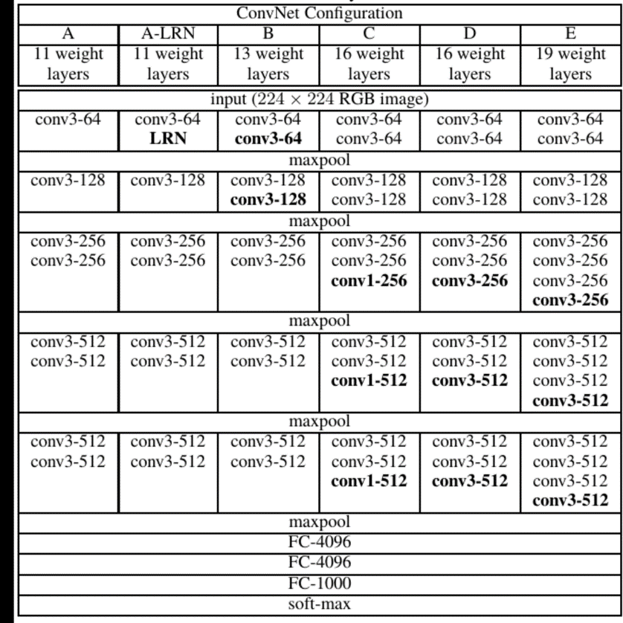
Faster RCNN
VGG

Slide 8
Faster RCNN
VGG16

Slide 9
Faster RCNN
Convolution
Maxpooling
….
(Feature
Extrector)
Transfer learing
(Classifier)
VGG16
Transfer learing

Slide 10
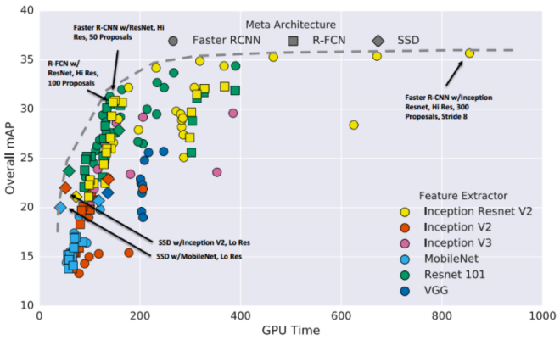
Faster RCNN

Slide 11
Faster RCNN

Slide 12
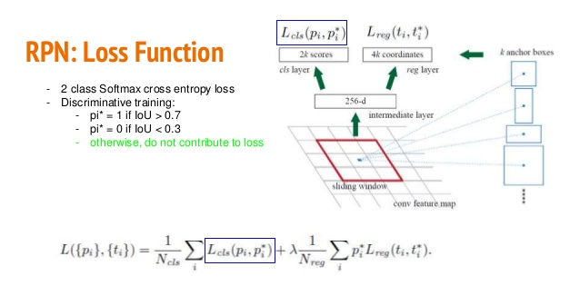
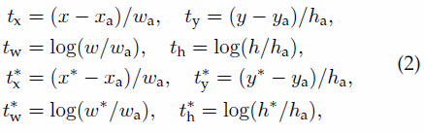
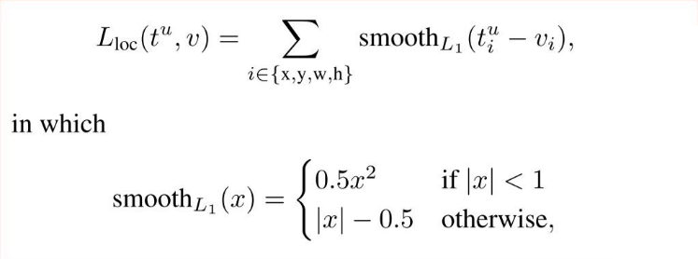
Loss Function

Slide 13
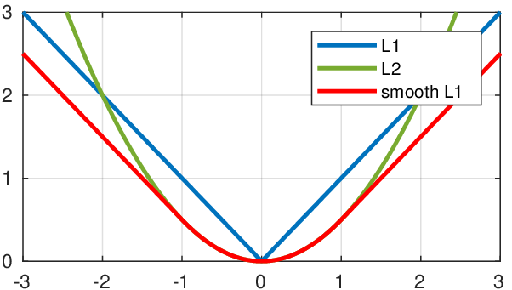

Smooth L1 Loss

Slide 14
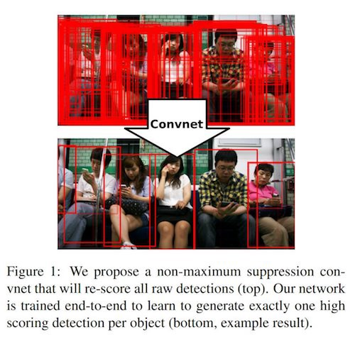
Non Maximum Suppression

Slide 15
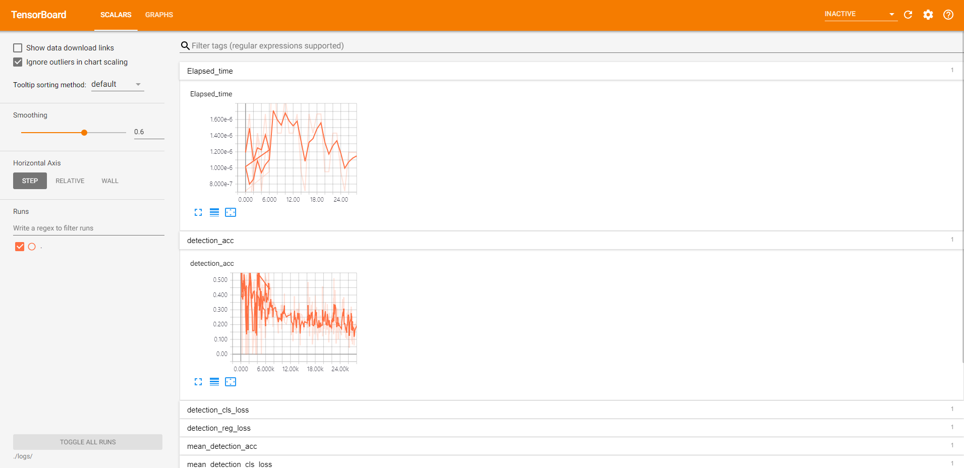
TensorBoard
tensorboard --logdir= ‘logs 디렉토리 경로’

Slide 16

Test – Youtube video
https://youtu.be/vASw0m6YdWs

